Slide 1
Data Streaming in a Real World Application
Gustavo Almeida – May, 2020

Slide 2
Define the workshop vision and goals
Day 1
Introductory Concepts
Sprint Presentation
Day 2
Intro to Computer Vision
Annotation
Day 3
Applied Object Classification
Object Detection
Day 4
Day 5
Cloud Services
Amazon and Google
Preparation for Project execuction
Readings

Slide 3
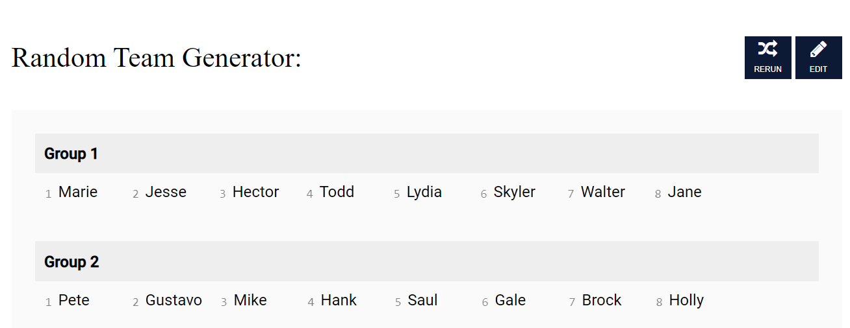
Get the Groups
https://www.randomlists.com/team-generator?grp=2&items=

Slide 4
Key Concepts – Read a paper
Framework / Library
Backbone network
One Stage vs Two Stages
Model Size
Similar to the SSD, we adopted VGG16 [32] to build our
base net, inheriting the first 13 layers. Also, we changed the last two fully connected layers as convolution layers.
Then several more convolutional feature layers were added to the end of truncated base network. Eventually, our Point-to-Tell net is a 23 layers fully connected neural network, the feature layers are from layer conv6-2, conv7- 2, conv8-2 and conv9-2.

Slide 5
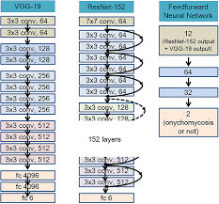
Summary – Backbones
VGGNet, ResNet, Inception, and Xception comparison
Densely connected Backbones ResNet , ResNeXt, AmoebaNet or lightweight backbones like MobileNet, ShuffleNet , SqueezeNet, Xception, MobileNetV2.
When applied to mobile devices, lightweight backbones can meet the requirements.
https://www.pyimagesearch.com/2017/03/20/imagenet-vggnet-resnet-inception-xception-keras/

Slide 6
AI – Applied to Cyber Security
A "Dear Colleague" letter is an official correspondence which is sent by a Member, committee, or officer of the United States House of Representatives or United States Senate and which is distributed in bulk to other congressional offices.
This DCL seeks to promote exploration of possible partnerships between AI researchers, cybersecurity researchers, and education researchers in order to inspire novel education and outreach efforts. Such collaborative efforts could also foster a robust workforce with integrated AI and cybersecurity competencies, and develop an informed public that understands the privacy, confidentiality, ethics, safety, and security implications of AI.
https://www.nsf.gov/pubs/2020/nsf20072/nsf20072.jsp?WT.mc_id=USNSF_25&WT.mc_ev=click

Slide 7
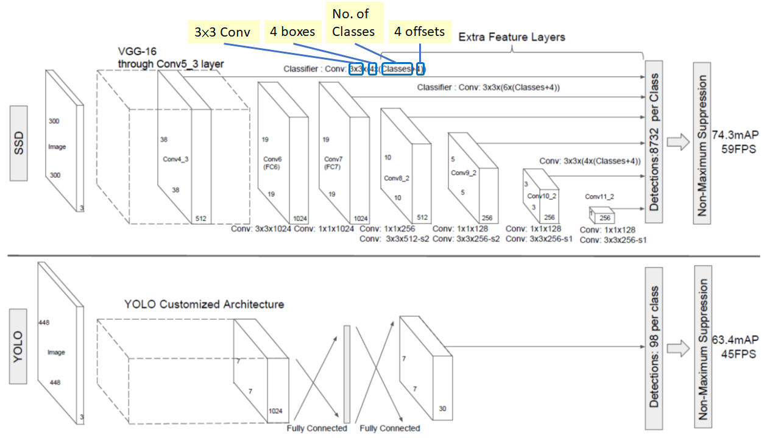
How it Really Works: Math and Visual
Algorithm Inner Workings / Math
Feature Visualization
How neural networks build up their understanding of images
https://towardsdatascience.com/review-ssd-single-shot-detector-object-detection-851a94607d11
https://distill.pub/2017/feature-visualization/

Slide 8
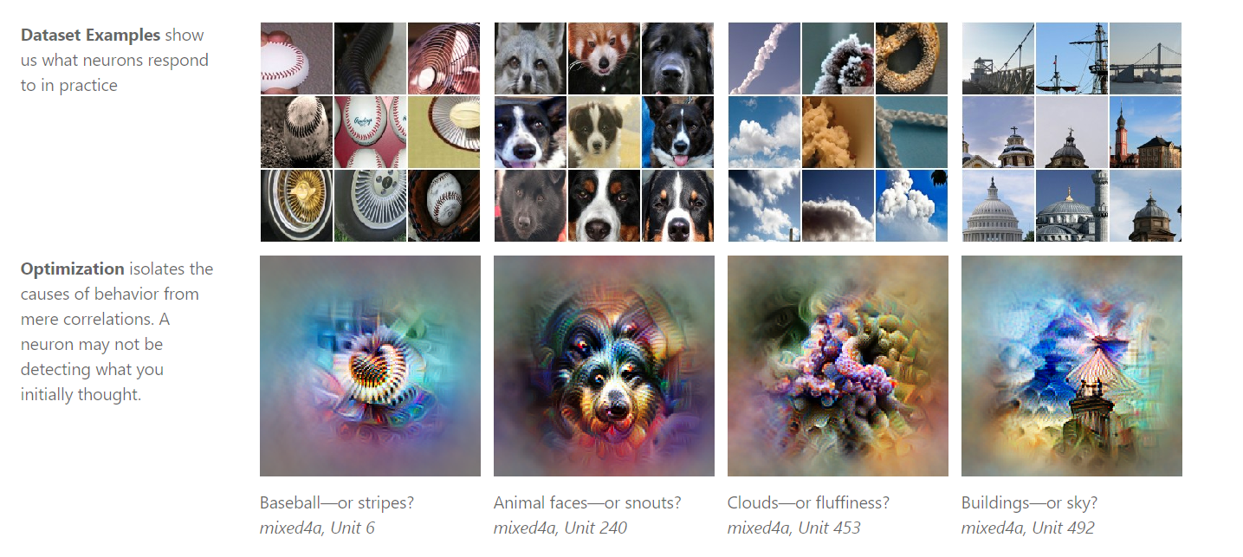
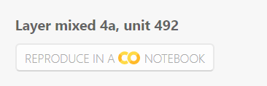
Feature – Interactive Tools
Neural networks are, generally speaking, differentiable with respect to their inputs. If we want to find out what kind of input would cause a certain behavior — whether that’s an internal neuron firing or the final output behavior — we can use derivatives to iteratively tweak the input towards that goal

Slide 9
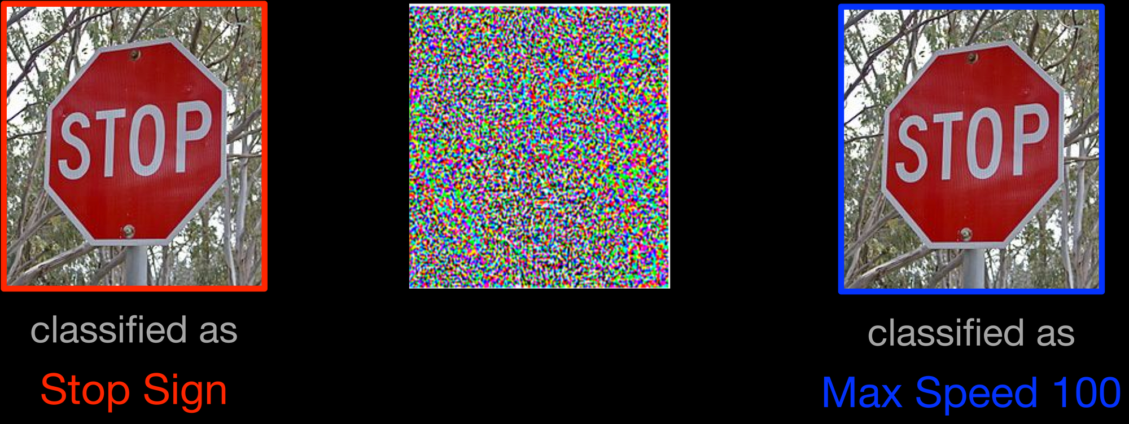
Adversarial examples

Slide 10

Adversarial examples
Adversarial examples are inputs to machine learning models that an attacker has intentionally designed to cause the model to make a mistake; they’re like optical illusions for machines.
https://openai.com/blog/adversarial-example-research/
starting with an image of a panda, the attacker adds a small perturbation that has been calculated to make the image be recognized as a gibbon with high confidence.

Slide 11
Other Resources - Information
Information, Tutorials and Step by Step Guide
https://colab.research.google.com/drive/1Mh2HP_Mfxoao6qNFbhfV3u28tG8jAVGk (in the DS Sprint)
https://www.youtube.com/watch?v=10joRJt39Ns&t=1498s

Slide 12
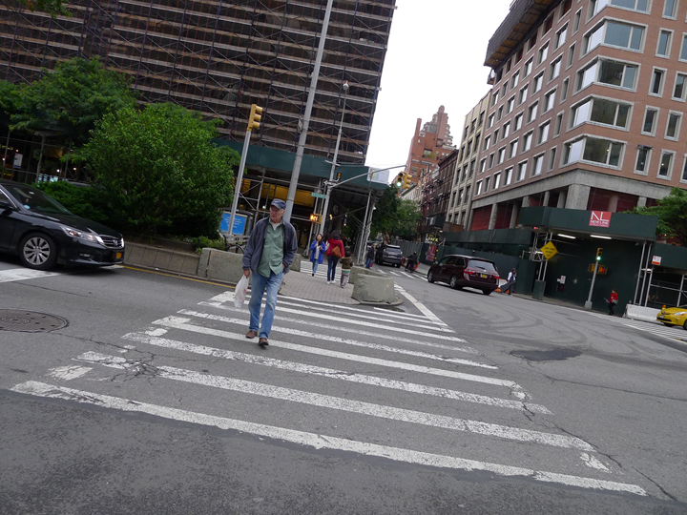
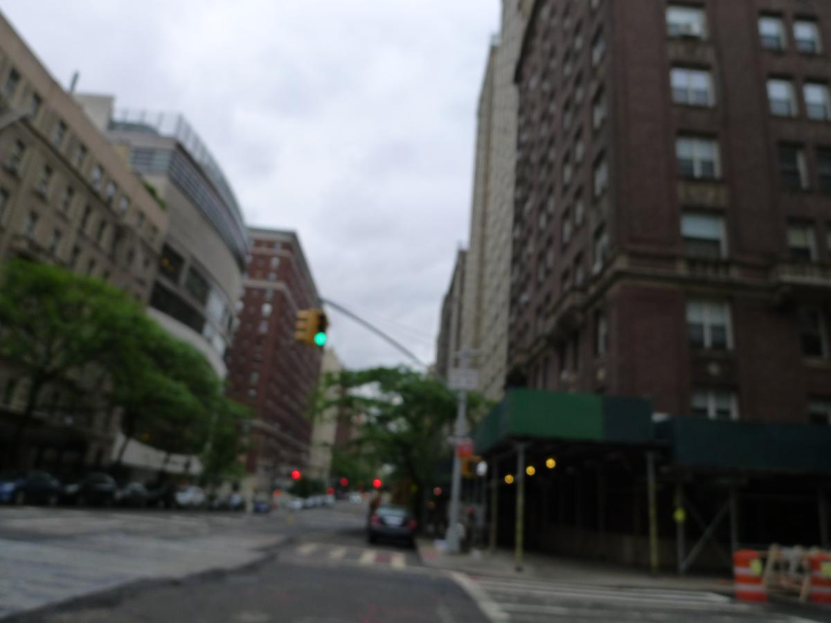
Preparation for Data Analysis
Number of Files:
9179 JPEG Images = Total Aprox. 12,8 GB
Different Resolutions - 1200 X 900 px = 249 KB to 3648 x 2736 px = 4,5 MB
Labeled Images: 6221 - ~ 70 %
Links to zip and Cyverse are available

Slide 13
Simulated vs Real
Group Decision:
Any meetings with the Sponsors ?
Final Presentation next Friday ?
What would be our dynamics ? Let’s try to do a “stand up meeting” ?

Slide 14

“UA Resources” Team – Group 1
Verify the possibilities: HPC, DE and/or Local Machines
There is the possibility of allocating GPUs to whatever tool we need – Tyson
Verify and list the possible resources for doing this task – including limits

Slide 15

“External Resources” Team – Group 2
Experiment at least two/ideally three possibilities of training the model and inferring on “external resources”
Aim for free resources for the initial phases, but contact me during the week if a rent by time solution is necessary
Verify possibilities for Model Training, but also inference

Slide 16
Other take-aways
It is crucial to think about solutions that have a fast inference – Yolo/SSD and are able to run on the edge/cloud
Look for benchmarks and latest versions of Network Object Detection (Yolo 9000, Yolo V4 )
Read the Object Detection Survey & Edge Computing – it will save you a lot of time
Try to work on a subsample – 10,000 images take a lot of time to train, specially on early stages.
Verify if down sampling or normalizing is needed by your tool of choice
CSV vs XML

Slide 17
BIG QUESTIONS
Can we do that ? (resources)
How long it would take ?
How much it would cost ?
What would be the architecture ?

Slide 18
Important, but detailed questions
What network detection e.g. (VGG16, VGG19, ResNet50, Inception V3, and Xception)
Framework / Libraries / Setup (Reproducibility)
Hardware employed – ideal vs possible
Next steps – what would be better to have ?

Slide 19
Desirable Outcomes
Verify the feasibility of doing this task for your conditions
Think about price, cost, time, human resources
Describe the learning experience
What went well, what did not went well
Experiment - A LOT
Reach out at ANYTIME !

